Slide 1

Deja Vu: Continual Model Generalization for Unseen Domains
Authors: Chenxi Liu, Lixu Wang, Lingjuan Lv, Chen Sun, Xiao Wang, Qi Zhu
Venue: ICLR 2023
Overview:
Continual learning models often fail in dynamic environments where data distribution changes over time.
This paper introduces RaTP, a framework designed to handle continual domain shifts effectively by focusing on generalization, adaptation, and knowledge retention.
Objective:
Highlight the problem of poor model performance during domain shifts and propose a solution that surpasses existing methods.

Slide 2
Challenges in Non-stationary Environments
Key issue:
Deep learning models struggle when trained on a single domain and deployed in unseen, dynamically changing domains.
Models experience a sharp drop in performance during unfamiliar periods, i.e., before adapting to the new domain.
Limitations of existing Approaches:
Domain Adaptation (DA):
Performs well after long adaptation periods, but is ineffective during domain shifts.
Domain Generalization (DG):
Focuses on cross-domain generalization but often suffers from catastrophic forgetting in continually changing environments.
Real-World Scenarios:
Surveillance: Systems fail under unfamiliar weather/lighting conditions.
Medical Imaging: Inability to detect new virus strains without extensive data.
Problem Statement:
How can we improve performance before and during domain shifts while retaining knowledge of past domains?

Slide 3
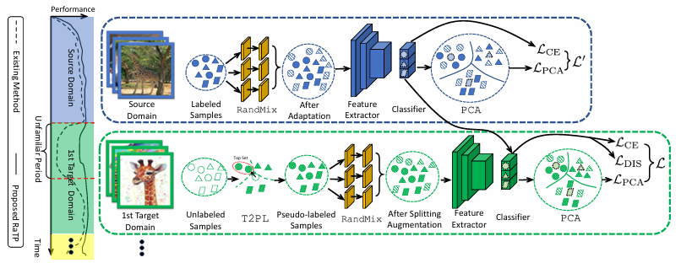
Proposed solution RaTP
Objective:
Enhance model performance during and after domain shifts.
Key Challenges Addressed:
Generalize to unseen target domains (TDG).
Adapt quickly to new domains (TDA).
Prevent knowledge loss (FA).
Components:
RandMix: Generates augmented data to improve generalization.
T2PL: Reliable pseudo-labeling mechanism for accurate domain adaptation.
PCA: Aligns domain prototypes to reduce adaptation gaps.

Slide 4

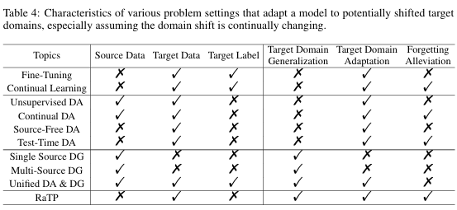
Comparison with Existing Approaches
Prior Methods:
Fine-Tuning: Requires labeled target data but struggles with catastrophic forgetting.
Continual Learning: Handles forgetting but fails to adapt without labeled data.
Domain Generalization:Effective for stationary domains but ineffective during continual shifts.
How RaTP differs:
Integrates DA and DG techniques for continual learning.
Simultaneously addresses generalization, adaptation, and forgetting alleviation.

Slide 5
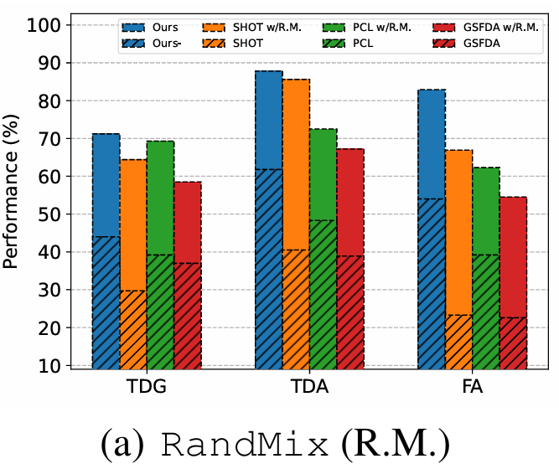

RANDMIX: TRAINING-FREE DATA AUGMENTATION
Objective:
Generate diverse data to improve generalization from the source domain to target domains.
How It Works:
Uses autoencoders for augmenting data with added noise.
Ensures robustness by creating variations in the target data.
Advantages:
Improves cross-domain transferability.
Handles low-quality target domains effectively.

Slide 6
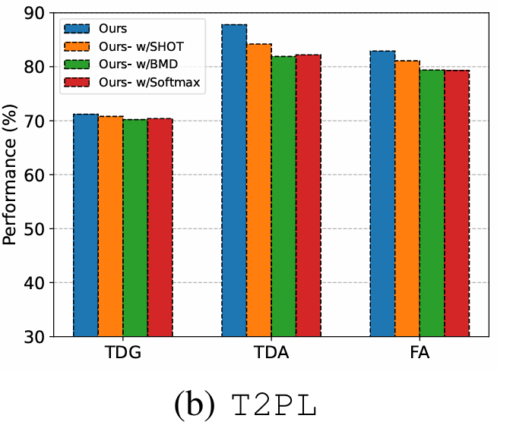

T2PL: TOP-PSEUDO LABELING
Objective:
Provide reliable pseudo-labels to improve domain adaptation accuracy.
How It Works:
Selects top 50% samples based on softmax confidence.
Constructs class centroids using cosine similarity:
Assigns labels using kNN on centroid-aligned features.
Advantages:
Reduces misclassification by focusing on high-confidence samples.
Ensures better alignment with target domain features.

Slide 7
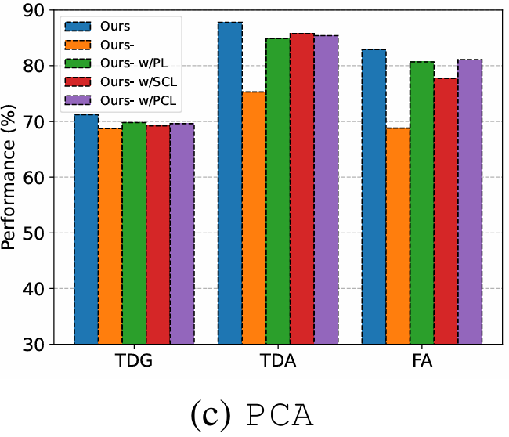

PCA: PROTOTYPE CONTRASTIVE ALIGNMENT
Objective:
Align domain prototypes to reduce the adaptation gap.
How It Works:
Prototypes are computed using:
Contrastive loss for prototype alignment:
sim(zi​,zj​) measures similarity between embeddings.
τ is a temperature scaling factor.
Aligns source and target prototypes while maintaining class distinctions.
Advantages:
Bridges the gap between domain-specific features.
Improves distinguishability between classes.

Slide 8
DATASETS AND METRICS
Datasets:
Digits: MNIST, USPS, SVHN, etc.
PACS: Photo, Art, Cartoon, Sketch.
DomainNet: Quickdraw, Infograph, Real, etc.
Metrics:
TDG: Performance before domain adaptation.
TDA: Performance after immediate adaptation.
FA: Performance after training with other domains.
Training Details:
Optimized using SGD with specific learning rates and memory constraints.

Slide 9
PERFORMANCE ACROSS DATASETS
EFFECTIVENESS OF MODULES
Digits:
RaTP achieves the best scores across TDG(76.8%), TDA(88.7%), and FA(85.0%).
RandMix:
Critical for generalization.
Removing it causes significant performance drops
PACS:
RaTP achieves the best scores across TDG(70.5%), TDA(83.8%), and FA(83.6%).
T2PL and PCA:
DomainNet:
Considerable scores in TDG (55.5%), TDA (67.6%), and FA (65.6%).
Validate their effectiveness in improving adaptation and alleviation.

Slide 10
CONCLUSION
Why RaTP Stands Out
Combines generalization, adaptation, and forgetting alleviation.
Achieves superior performance across datasets.
Practical applicability in non-stationary environments.

